Slide 1
CS 2212
Introduction to Software Engineering
Chapter 3 Agility and Process

Slide 2
Copyright Notice This Presentation and Its Associated Video Contain Copyright Material. This Presentation and Its Associated Video Are Provided for Teaching Purposes of CS2212 and Should Not Be Posted In Any External Site, Or Shared with. This Presentation and Its Associated Video Are Provided For Instructional Personal Use Only, and Only For The Purposes of the CS2212 Course.

Slide 3
Part 12
SCRUM
Software is easy to make, except when you want it to do something new. And then, of course, there is a corollary: The only software that's worth making is software that does something new.
- Scott Rosenberg
Notes:
This lesson introduces the basic steps in a software engineering project at a high level.
In practice, steps often overlap.

Slide 4
Learning Objectives in this Part
To understand the SCRUM process model

Slide 5
Scrum in 100 words
Scrum is an agile process that allows us to focus on delivering the highest business value in the shortest time.
It allows us to rapidly and repeatedly inspect actual working software (every two weeks to one month).
The business sets the priorities. Teams self-organize to determine the best way to deliver the highest priority features.
Every two weeks to a month anyone can see real working software and decide to release it as is or continue to enhance it for another sprint.
Mountain Goat Software, LLC, www.mountaingoatsoftware.com

Slide 6





Scrum
24 hours
Sprint
2-4 weeks
Sprint goal
Return
Sprint backlog
Potentially shippable
product increment
Return
Cancel
Gift wrap
Coupons
Gift wrap
Cancel
Coupons
Product
backlog
Mountain Goat Software, LLC, www.mountaingoatsoftware.com

Slide 7
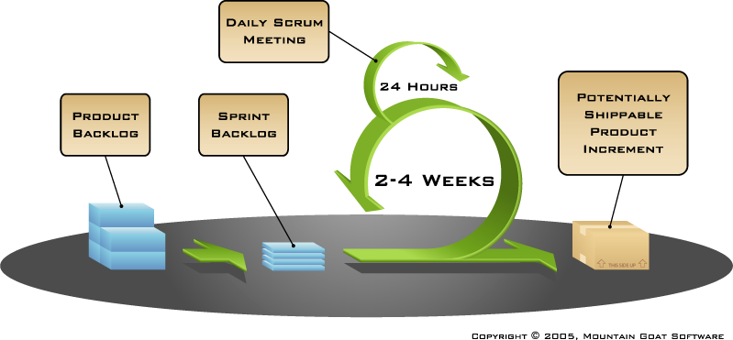
Putting it all together
Image available at www.mountaingoatsoftware.com/scrum
Mountain Goat Software, LLC, www.mountaingoatsoftware.com

Slide 8
Sprints
Scrum projects make progress in a series of “sprints”
Analogous to Extreme Programming iterations
Typical duration is 2–4 weeks or a calendar month at most
A constant duration leads to a better rhythm
Product is designed, coded, and tested during the sprint

Slide 9

Scrum framework
Roles
Product owner
ScrumMaster
Team
Ceremonies
Sprint planning
Sprint review
Sprint retrospective
Daily scrum meeting
Artifacts
Product backlog
Sprint backlog
Burndown charts
Mountain Goat Software, LLC, www.mountaingoatsoftware.com

Slide 10
Scrum framework
Roles
Product owner
ScrumMaster
Team
Ceremonies
Sprint planning
Sprint review
Sprint retrospective
Daily scrum meeting
Artifacts
Product backlog
Sprint backlog
Burndown charts
Mountain Goat Software, LLC, www.mountaingoatsoftware.com

Slide 11

Product owner
Define the features of the product
Decide on release date and content
Be responsible for the profitability of the product (ROI)
Prioritize features according to market value
Adjust features and priority every iteration, as needed
Accept or reject work results
Mountain Goat Software, LLC, www.mountaingoatsoftware.com

Slide 12

The ScrumMaster
Represents management to the project
Responsible for enacting Scrum values and practices
Removes impediments
Ensure that the team is fully functional and productive
Enable close cooperation across all roles and functions
Shield the team from external interferences
Mountain Goat Software, LLC, www.mountaingoatsoftware.com

Slide 13





The team
Typically 5-9 people
Cross-functional:
Programmers, testers, user experience designers, etc.
Members should be full-time
May be exceptions (e.g., database administrator)
Teams are self-organizing
Ideally, no titles but rarely a possibility
Membership should change only between sprints
Mountain Goat Software, LLC, www.mountaingoatsoftware.com

Slide 14
Scrum framework
Roles
Product owner
ScrumMaster
Team
Ceremonies
Sprint planning
Sprint review
Sprint retrospective
Daily scrum meeting
Artifacts
Product backlog
Sprint backlog
Burndown charts
Mountain Goat Software, LLC, www.mountaingoatsoftware.com

Slide 15



Team capacity
Sprint planning meeting
Sprint prioritization
Product backlog
Sprint
goal
Analyze and evaluate product backlog
Select sprint goal
Business conditions
Sprint planning
Decide how to achieve sprint goal (design)
Create sprint backlog (tasks) from product backlog items (user stories / features)
Estimate sprint backlog in hours
Current product
Sprint
backlog
Technology
Mountain Goat Software, LLC, www.mountaingoatsoftware.com

Slide 16

Sprint planning
Team selects items from the product backlog they can commit to completing
Sprint backlog is created
Tasks are identified and each is estimated (1-16 hours)
Collaboratively, not done alone by the ScrumMaster
High-level design is considered
As a vacation planner, I want to see photos of the hotels.
Code the middle tier (8 hours)
Code the user interface (4)
Write test fixtures (4)
Code the foo class (6)
Update performance tests (4)
Mountain Goat Software, LLC, www.mountaingoatsoftware.com

Slide 17
The daily scrum
Parameters
Daily
15-minutes
Stand-up
Not for problem solving
Whole world is invited
Only team members, ScrumMaster, product owner, can talk
Helps avoid other unnecessary meetings
Mountain Goat Software, LLC, www.mountaingoatsoftware.com

Slide 18

Everyone answers 3 questions
1
What did you do yesterday?
2
What will you do today?
3
Is anything in your way?
These are not status for the ScrumMaster
They are commitments in front of peers
Mountain Goat Software, LLC, www.mountaingoatsoftware.com

Slide 19
The sprint review
Team presents what it accomplished during the sprint
Typically takes the form of a demo of new features or underlying architecture
Informal
2-hour prep time rule
No slides
Whole team participates
Invite the world
Mountain Goat Software, LLC, www.mountaingoatsoftware.com

Slide 20
Sprint retrospective
Periodically take a look at what is and is not working
Typically 15–30 minutes
Done after every sprint
Whole team participates
ScrumMaster
Product owner
Team
Possibly customers and others
Mountain Goat Software, LLC, www.mountaingoatsoftware.com

Slide 21

Start / Stop / Continue
Whole team gathers and discusses what they’d like to:
Start doing
Stop doing
This is just one of many ways to do a sprint retrospective.
Continue doing
Mountain Goat Software, LLC, www.mountaingoatsoftware.com

Slide 22
Scrum framework
Roles
Product owner
ScrumMaster
Team
Ceremonies
Sprint planning
Sprint review
Sprint retrospective
Daily scrum meeting
Artifacts
Product backlog
Sprint backlog
Burndown charts
Mountain Goat Software, LLC, www.mountaingoatsoftware.com

Slide 23

Product backlog
The requirements
A list of all desired work on the project
Ideally expressed such that each item has value to the users or customers of the product
Prioritized by the product owner
Reprioritized at the start of each sprint
This is the product backlog
Mountain Goat Software, LLC, www.mountaingoatsoftware.com

Slide 24
A sample product backlog
Backlog item | Estimate
Allow a guest to make a reservation | 3
As a guest, I want to cancel a reservation. | 5
As a guest, I want to change the dates of a reservation. | 3
As a hotel employee, I can run RevPAR reports (revenue-per-available-room) | 8
Improve exception handling | 8
... | 30
... | 50
Mountain Goat Software, LLC, www.mountaingoatsoftware.com

Slide 25
The sprint goal
A short statement of what the work will be focused on during the sprint
Life Sciences
Support features necessary for population genetics studies.
Database Application
Make the application run on SQL Server in addition to Oracle.
Financial services
Support more technical indicators than company ABC with real-time, streaming data.
Mountain Goat Software, LLC, www.mountaingoatsoftware.com

Slide 26
Managing the sprint backlog
Individuals sign up for work of their own choosing. Work is never assigned
Estimated work remaining is updated daily
Any team member can add, delete or change the sprint backlog
Work for the sprint emerges
If work is unclear, define a sprint backlog item with a larger amount of time and break it down later
Update work remaining as more becomes known
Mountain Goat Software, LLC, www.mountaingoatsoftware.com

Slide 27
A sprint backlog
Tasks
Mon
Tues
Wed
Thur
Fri
Code the user interface
8
4
8
Code the middle tier
16
12
10
4
Test the middle tier
8
16
16
11
8
Write online help
12
Write the foo class
8
8
8
8
8
Add error logging
8
4
Mountain Goat Software, LLC, www.mountaingoatsoftware.com

Slide 28

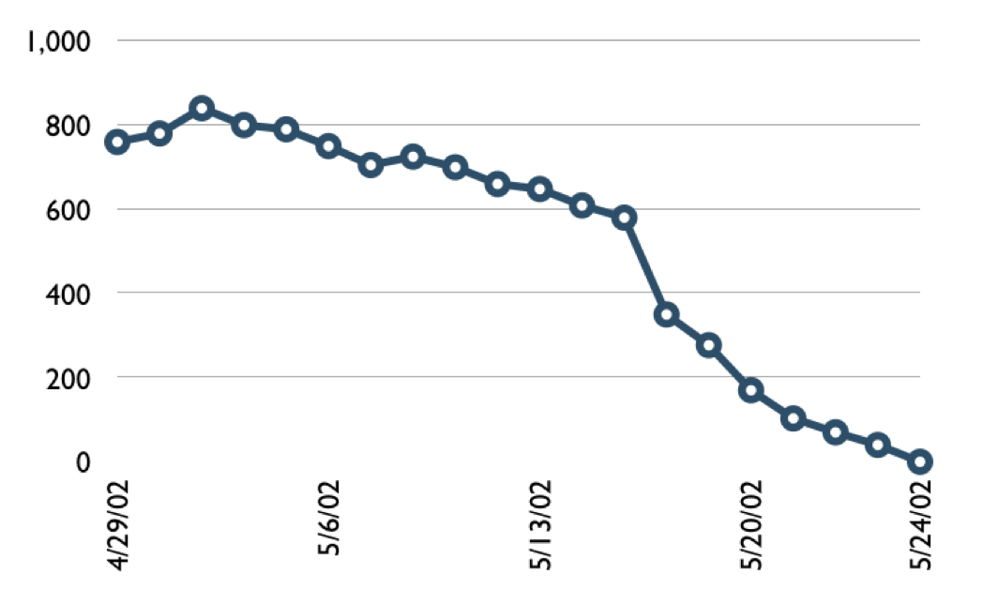
A sprint burndown chart
Hours
Mountain Goat Software, LLC, www.mountaingoatsoftware.com

Slide 29
Tasks
Mon
Tues
Wed
Thur
Fri
Code the user interface
8
4
8
Code the middle tier
16
12
10
7
Test the middle tier
8
16
16
11
8
Write online help
12
50
40
30
Hours
20
10
0
Mon
Tue
Wed
Thu
Fri
Mountain Goat Software, LLC, www.mountaingoatsoftware.com

